Slide 1
Functional redundancy as a mechanism to explain extracellular enzyme responses to drought

Slide 2
Purpose
Outline of discussion section of manuscript

Slide 3
Statistical Analysis

Slide 4
Datasets
Enzyme V_{max}
Litter chemistry functional groups
CAZyme domain relative abundance & total counts

Slide 5
Enzymes
Enzyme | Acronym | Substrate | Nutrient cycled | EC
α-glucosidase | AG | Starch | Carbon | 3.2.1.20
(acid) phosphatase | AP | Organic phosphorus | Phosphorus | 3.1.3.2
β-glucosidase | BG | Cellulose | Carbon | 3.2.1.21
β-xylosidase | BX | Hemicellulose | Carbon | 3.2.1.37
cellobiohydrolase | CBH | Cellulose | Carbon | 3.2.1.91
leucine aminopeptidase | LAP | Proteins | Nitrogen | 3.4.11.1
N-acetyl-β-D-glucosaminidase | NAG | Chitin | Nitrogen | 3.1.6.1
polyphenol oxidase | PPO | Lignin | Carbon | 1.10.3.2
peroxidase | PER | Lignin | Carbon | 1.11.1.7

Slide 6
Enzyme activity
Enzyme activity is converted from raw fluorescence & absorbance values using equations from German et al 2011
Enzyme activity (micromole/L/g dry litter/hr) plotted against substrate concentration (micromole/L)
Judged visually for 2 possible artifacts
Negative enzyme activity
Substrate inhibition

Slide 7
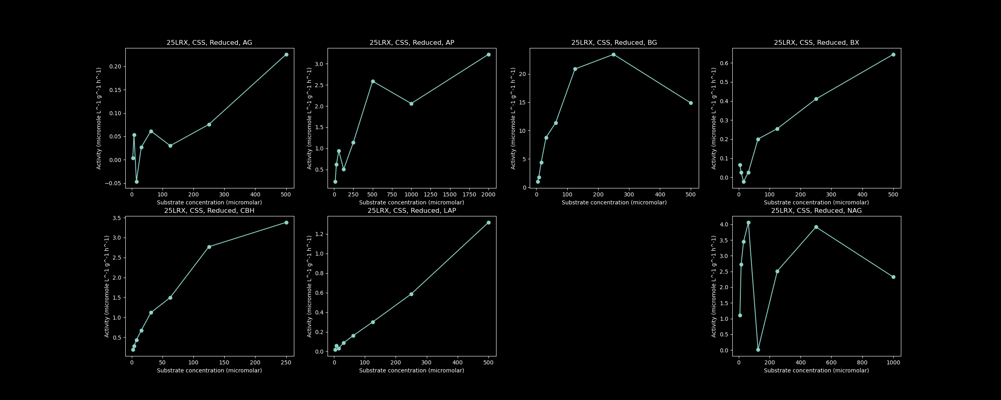
Negative enzyme activity

Slide 8
Substrate inhibition
Michaelis-Menten kinetics predicts that enzyme activity approaches V_{max} as substrate concentration approaches infinity
Substrate inhibition: high substrate concentrations inhibit enzyme activity, lowering enzyme activity as substrate concentration increases
Causes underestimates of V_{max} if not accounted for (Steen & Ziervogal 2012)

Slide 9
Substrate inhibition

Slide 10
Removing artifacts
Enzyme activity is set to 0 if it is negative
Substrate concentrations that show substrate inhibition were removed
Once artifacts were removed, the Michaelis-Menten equation is fitted to the cleaned data, producing V_{max} and K_{m} values for each enzyme

Slide 11
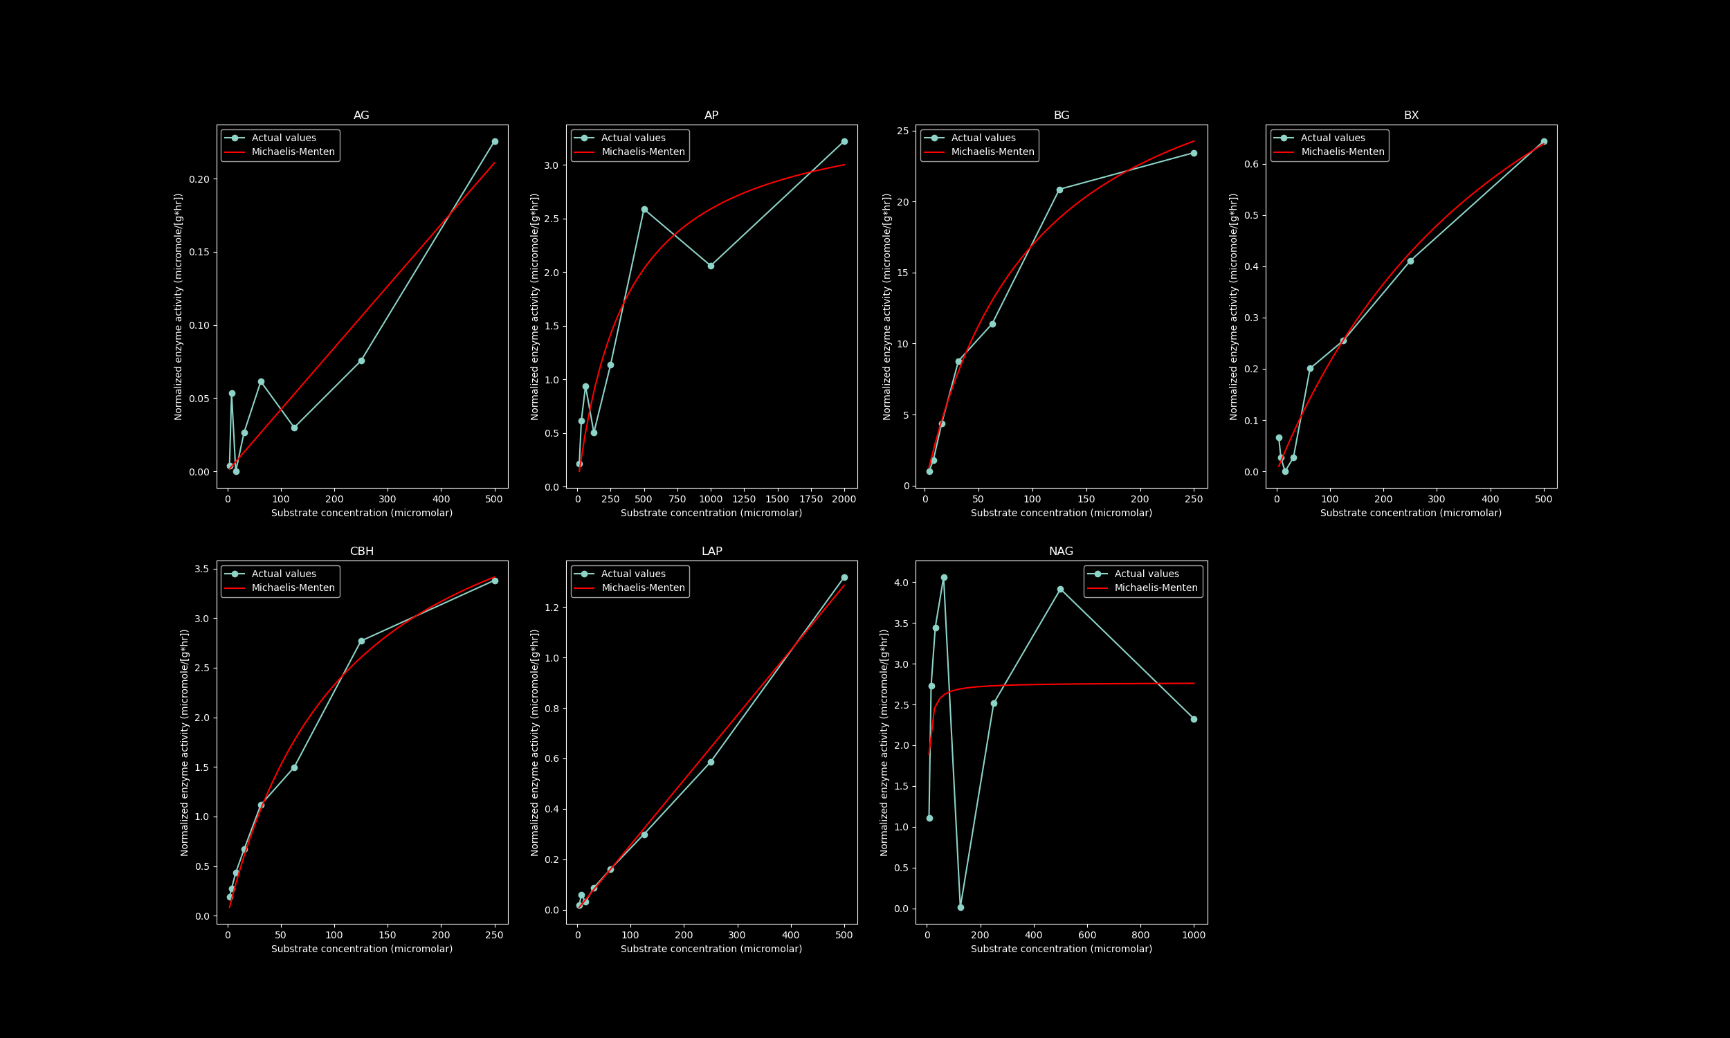
Cleaned enzyme activity and fitted Michaelis-Menten model

Slide 12
Litter chemistry
FTIR frequency range: 900 – 1800 cm⁻¹
Following values were calculated for each litter sample at each time point
Total area under the curve (A_{total})
Area under the curve for each functional group (A_{fg})
Percent area of each functional group (%A_{fg}) is calculated as follows
100% x A_{fg} / A_{total}
Kind of a relative abundance of each functional group
Statistical analysis is conducted on this percent area

Slide 13
Functional groups
FTIR spectral range | Original name | New name | Functional group
970 - 1015 | carbo1 | carboEster1 | carbohydrate esters
1015 - 1080 | carbo2 | glycosidicBond | glycosidic bonds
1100 - 1160 | carbo3 | carboEster2 | carbohydrate esters
1160 - 1230 | carbo4 | C_O_stretching | carbohydrate C-O stretches
1450 - 1475 | alkane | alkane | single bonds
1545 - 1600 | amide1 | amide1 | amide
1620 - 1645 | amide2 | amide2 | amide
1700 - 1750 | lipid | lipid | lipid

Slide 14
CAZyme domains data
Substrates: cellulose, hemicellulose, lignin, starch, miscellaneous polysaccharides, miscellaneous oligosaccharides, microbial cell walls, peptidoglycan
CAZymes can be extracellular or attached to microbial cell surface
A large protein (e.g. enzymes) can be divided into parts called domains that are encoded by separate genes

Slide 15
CAZyme domains data
Values calculated
Number of domains dedicated to a substrate (D_{sub})
Total number of domains dedicated to all prior substrates (D_{total})
Substrate domain relative abundance (RA_{sub}) calculated as
100% x D_{sub} / D_{total}
Dependent variables from this dataset:
RA_{sub} of all substrates
D_{total}

Slide 16
Dependent variables analyzed
Enzyme activity dataset
V_{max}
Litter chemistry dataset
%A_{fg}
CAZyme domain dataset
RA_{sub}
D_{total}

Slide 17
Statistical Analysis
Python 3.8.5
scipy 1.5.2
statsmodels 0.12.0
Steps
Check normality using Shapiro-Wilk test
Factorial ANOVAs (α = 0.05)
Tukey’s Honest Significant Difference (HSD) test as a post-hoc test (α = 0.05)

Slide 18
Normality
The Shapiro-Wilk test (α = 0.05) ran on each dependent variable for each treatment combination (vegetation x precipitation) at each time point
Transformations were conducted if data showed deviations from normality, then tested again with Shapiro-Wilk
Transformations were kept if transformations shown to improve normality

Slide 19
ANOVAs
Factorial ANOVAs with the following as between-subject factors: time points, vegetation, precipitation
Type 3 ANOVAs were ran repeatedly to test for interactions
Insignificant interactions removed after each iteration
3-way interaction removed, followed by 2-way interactions
No interactions removed if 3-way is significant
Type 2 ANOVAs were ran once on factors as main effects if no interactions were significant

Slide 20
Tukey’s post-hoc & significance
Ran on interactions/main effects ANOVA found to be significant
Significant interactions:
Significant under both ANOVA and Tukey’s
Significant main effects:
Significant under ANOVA & part of significant interactions
Not part of significant interactions, but significant under both ANOVA and Tukey’s
Partial eta-squared calculated for significant interactions & main effects using output from the last ANOVA iteration

Slide 21
Discussion (& Results)

Slide 22
V_{max}
Enzyme | timePoint | Vegetation | Precipitation | timePoint x Precipitation | timePoint x Vegetation | Vegetation x Precipitation | Three-way
AG
AP | 0.19581
BG |  | 0.325524
BX
CBH | 0.279755 | 0.839458 |  |  | 0.312995
LAP
NAG | 0.319957 | 0.748632 |  |  | 0.231837
PPO |  | 0.065505 |  |  |  |  | 0.074688

Slide 23
Enzyme response (or lack thereof) to drought
Studies show conflicting responses of extracellular enzyme activity to drought
Some studies show that enzyme amounts aren’t influenced by drought, either as a treatment (Steinweg et al. 2013) or as differences between rainy and dry seasons (Bell et al. 2009)
A mechanism for this lack of change
Decreases in enzyme production due to changes in litter chemistry (Alster et al. 2013)
Decreases in enzyme turnover due to a variety of factors – decrease protease amounts (Alster et al. 2013), adsorption of enzymes on leaf litter (Alster et al. 2013; Geisseler et al. 2011)

Slide 24
Enzyme response (or lack thereof) to drought
No decrease in protease amounts, so no decrease in breakdown of enzymes
Our data indicates that the prior mechanism isn’t present
New mechanism: lack of change in both enzyme production and enzyme turnover
Functional redundancy

Slide 25
Characteristics of functional redundancy
Functional redundancy: multiple species/taxa in an ecosystem performs similar functions (Jurburg & Salles, 2015; Louca et al. 2018)
Ecosystem function doesn’t change or restores back to original levels of function after a disturbance while community composition changes (Jurburg & Salles, 2015)
At high levels of functional redundancy, ecosystem function doesn’t change as species diversity changes (Jurburg & Salles, 2015)
Therefore, ecosystem function is decoupled from species diversity at high levels of redundancy

Slide 26
Functional redundancy
Domain relative abundance:
Species diversity
Functional redundancy
Enzyme V_{max}/amounts:
Ecosystem function
Predictions:
Function remains constant as species diversity changes or remains constant
Function may decrease (due to other factors) as species diversity changes

Slide 27
CAZyme domain
Substrate | timePoint | Vegetation | Precipitation | timePoint x Precipitation | timePoint x Vegetation | Vegetation x Precipitation | Three-way
Hemicellulose | 0.402257 | 0.495967 |  |  | 0.177708
Lignin | 0.168888 | 0.657846 | 0.320604 | 0.222007 |  |  | 0.157971
Polysaccharide | 0.285883 | 0.222261 |  |  |  |  | 0.152665
Oligosaccharides | 0.15423 | 0.224568 |  |  | 0.26663
Cell_wall | 0.422536 | 0.302124 |  |  |  |  | 0.204873
Inulin | 0.404075 | 0.125173 |  |  |  | 0.498296 | 0.284922
Starch |  |  |  |  |  | 0.097269
Trehalose | 0.28011 | 0.148858
Cellulose | 0.640673 | 0.157421 |  |  |  | 0.293885 | 0.353462
Pectin | 0.198508 |  | 0.167897 |  |  | 0.220195
Glycogen | 0.207871 |  |  |  | 0.235899
Peptidoglycan | 0.217589
Chitin | 0.180948
Total | 0.317959 | 0.437618 |  |  | 0.153434 |  | 0.185269

Slide 28
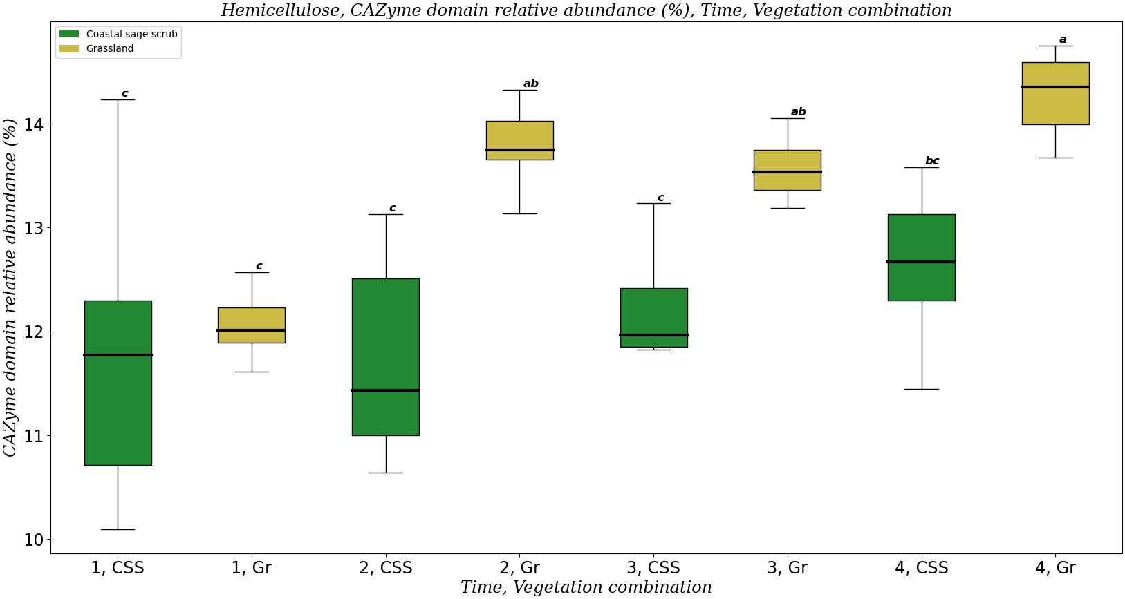
Hemicellulose
Enzyme | timePoint | Vegetation | Precipitation | timePoint x Precipitation | timePoint x Vegetation | Vegetation x Precipitation | Three-way
BX

Slide 29
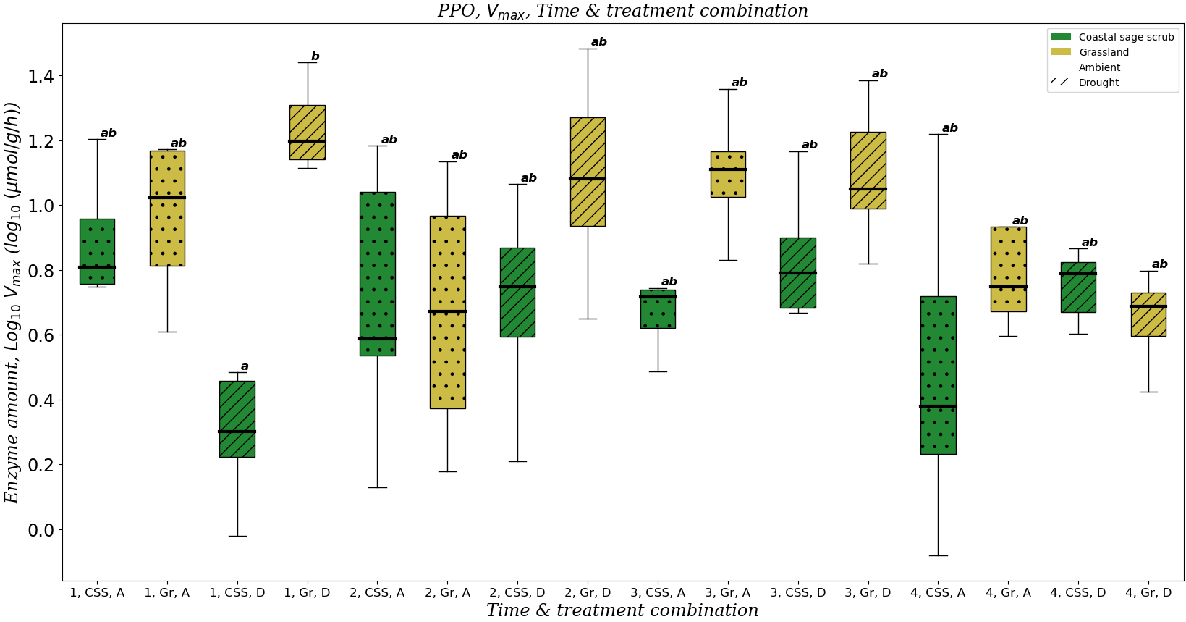
Lignin

Slide 30
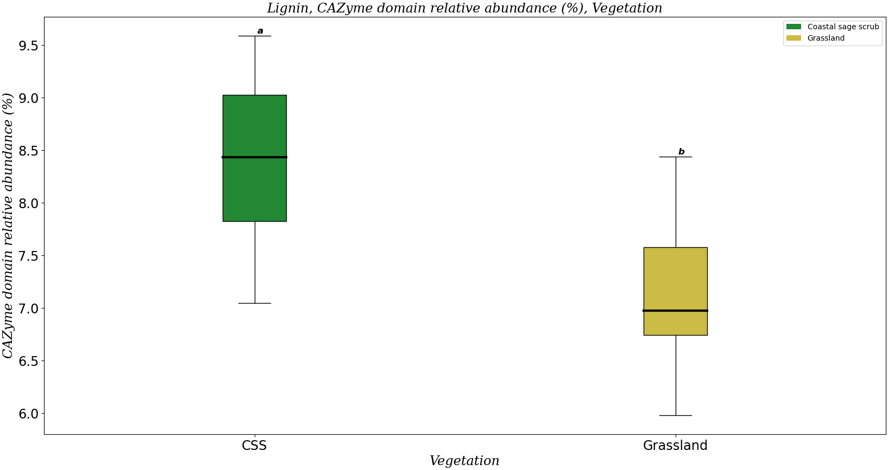
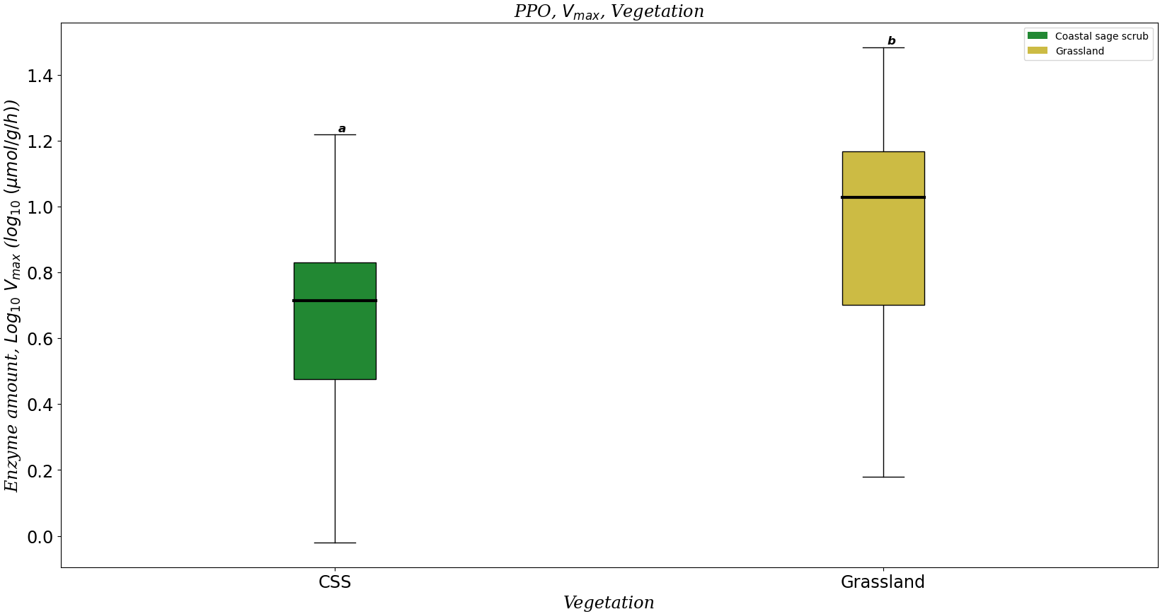
Lignin: vegetation

Slide 31
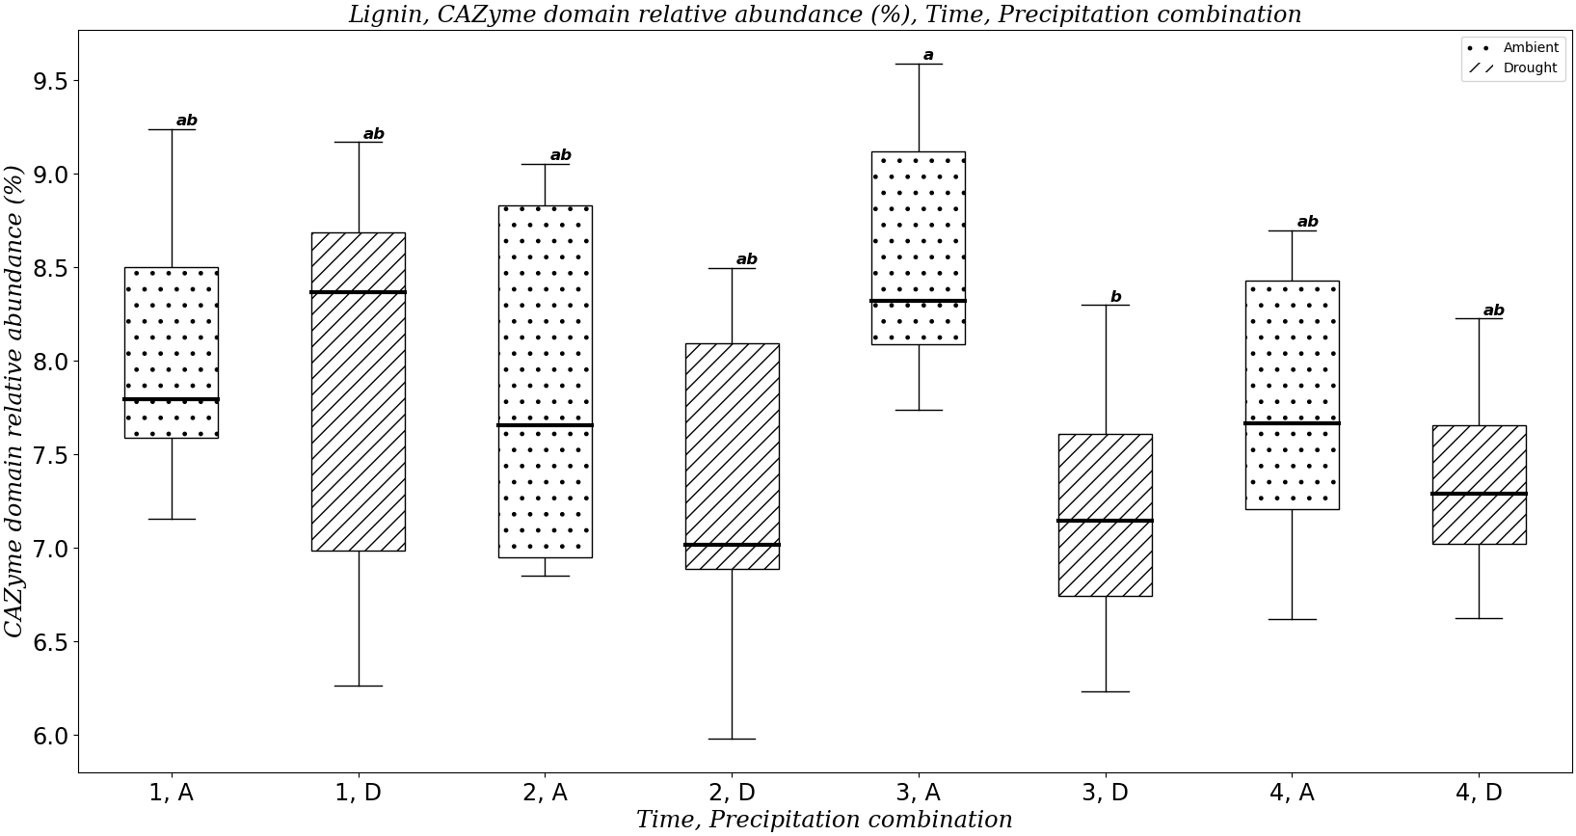
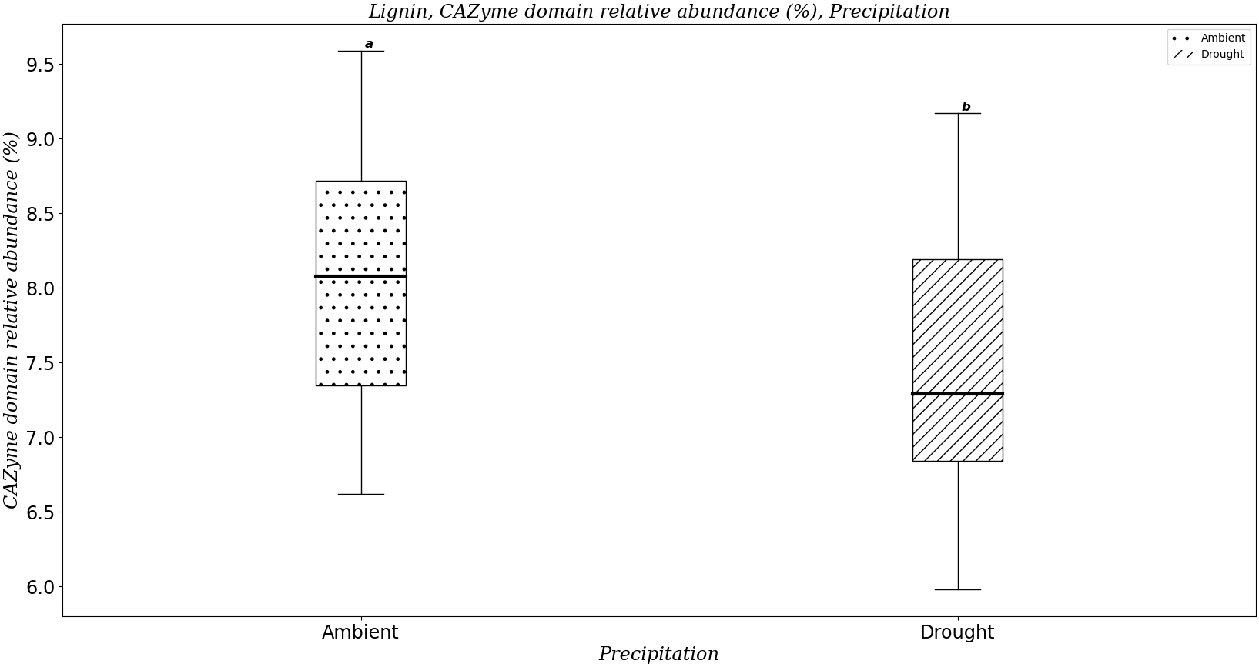
Lignin: precipitation
Enzyme | timePoint | Vegetation | Precipitation | timePoint x Precipitation | timePoint x Vegetation | Vegetation x Precipitation | Three-way
PPO |  | 0.065505 |  |  |  |  | 0.074688

Slide 32
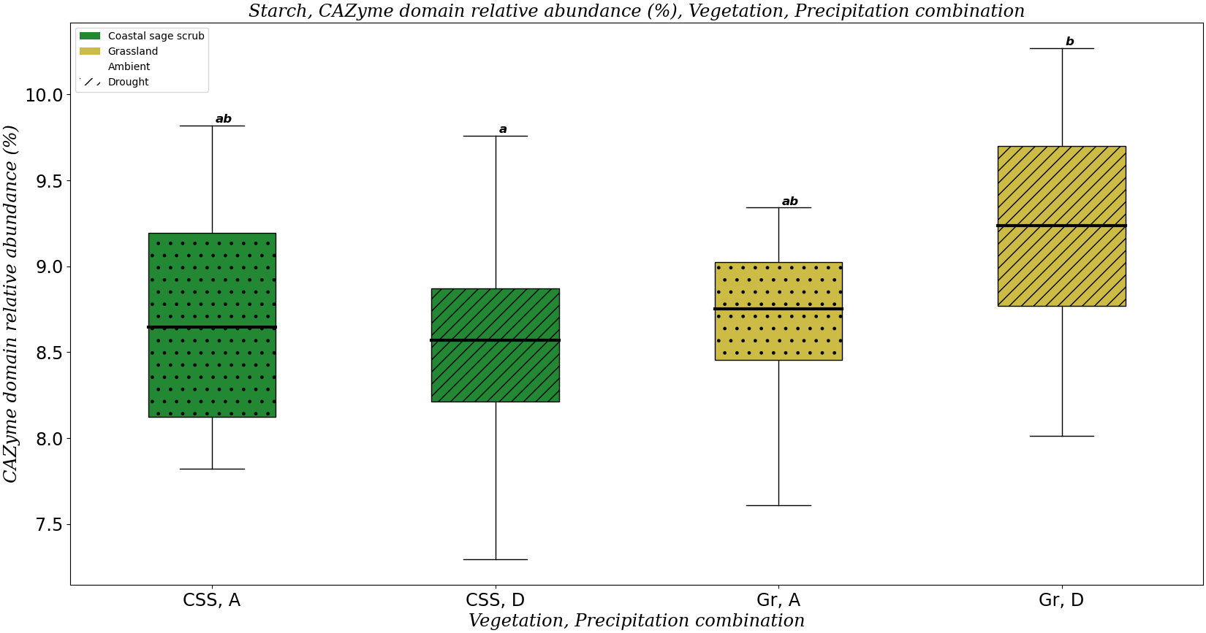
Starch
Enzyme | timePoint | Vegetation | Precipitation | timePoint x Precipitation | timePoint x Vegetation | Vegetation x Precipitation | Three-way
AG

Slide 33
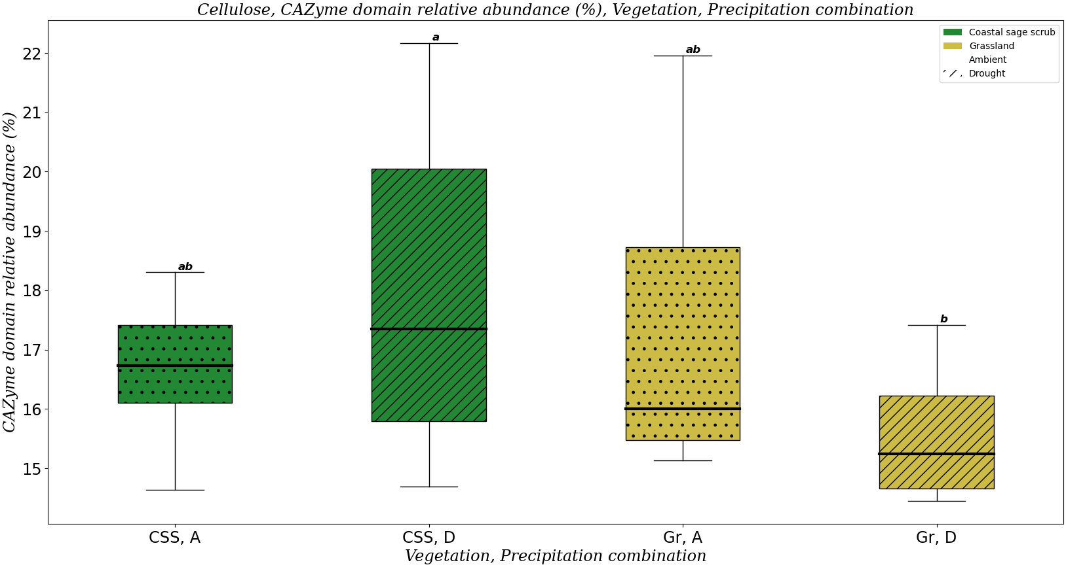
Cellulose: drought response
 | Enzyme/Substrate | timePoint | Vegetation | Precipitation | timePoint x Precipitation | timePoint x Vegetation | Vegetation x Precipitation | Three-way
Enzyme | BG |  | 0.325524
Enzyme | CBH | 0.279755 | 0.839458 |  |  | 0.312995
Substrate | Cellulose | 0.640673 | 0.157421 |  |  |  | 0.293885 | 0.353462

Slide 34
Chitin: drought response
 | Substrate | timePoint | Vegetation | Precipitation | timePoint x Precipitation | timePoint x Vegetation | Vegetation x Precipitation | Three-way
Substrate | Chitin | 0.180948
Enzyme | NAG | 0.319957 | 0.748632 |  |  | 0.231837
Lack of change in both domain relative abundance (species diversity) and enzyme amounts (ecosystem function) is also consistent with functional redundancy

Slide 35
Functional redundancy & drought
We observe functional redundancy in vegetation for hemicellulose, lignin, starch
Domain relative abundance and enzyme amounts are decoupled from each other when we vary vegetation
We also observe functional redundancy in response to drought for lignin, starch, cellulose, (chitin?)
Functional redundancy explains the lack of enzyme response to drought
Domain relative abundance (redundancy) is high enough that enzyme activity (function) doesn’t change with a disturbance

Slide 36
Functional redundancy & drought
Enzyme activity is constant with drought
New mechanism: enzyme production and enzyme turnover don’t change
Enzyme turnover doesn’t change: LAP amounts remain constant
Enzyme production remains constant due to functional redundancy
Consistent with Gao et al. 2021

Slide 37
Conceptual figure levels
Genes
CAZyme domains
Vmax
Litter chemistry
Bottom up view with the following direction of causation
Litter chemistry -> Genes -> CAZyme domains -> Vmax

Slide 38
Meeting notes
Chemistry as driver of genes
Use litter chemistry to explain why changes in genes are happening
Steve kind of agrees with functional redundancy, but Ashish doesn’t and suggests different terms, and Steve is fine with using different terms like “functional similarity” like in the paper he wrote with Jen Martiny
I think Ashish just doesn’t agree with my definition of functional redundancy, because he thinks that you would need to look at taxonomic diversity as well
Ashish suggested that maybe making the paper more descriptive than mechanistic

Slide 39
To-do list
Create a conceptual figure in which litter chemistry influences genes, which influences CAZyme domains, which influences Vmax
Create a presentation on litter chemistry & CAZyme domains
Analyze the link (or lack thereof) between litter chemistry and CAZyme domains, describing whether link exists
Talk about Ashish’s hypothesis of microbes growing with time and the amide functional group
I disagree with this hypothesis because there are more proteins in the drought treatment, so his hypothesis suggests that there’s more microbial biomass under drought, and I don’t think there’s evidence for that
asdf

